Slide 1
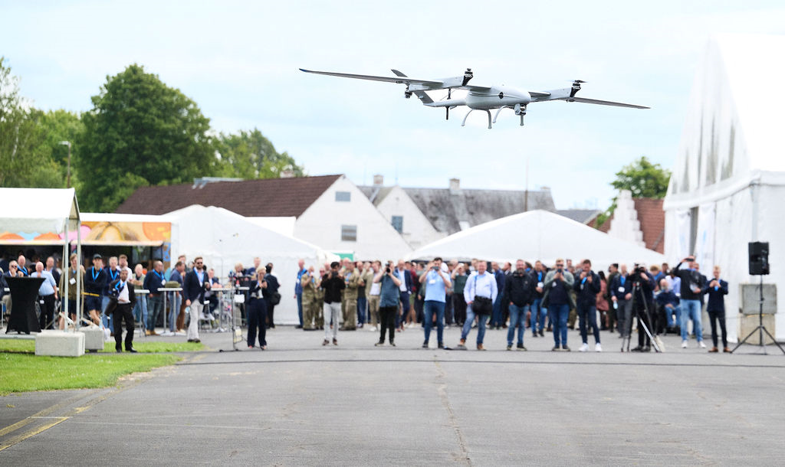




June 3-4, HCA Airport, Odense
The premier meeting point for the unmanned systems community
IDS is Europe’s leading industry platform for unmanned technologies across air, ground, and sea. The show gathers the global UAS community for innovation, collaboration, and real business opportunities.
What to expect from IDS 2026
Learn more and reserve your spot
1,500+ industry stakeholders – approx 40% internationals
140+ exhibitors
Demo flights
Talks & Panels across four themes: Defence and Security, Industry Use Cases & New Technologies, Integrated Airspace, UAS on land and sea
After-show networking events
Academic Symposium
B2B matchmaking meeting
IDS is produced by

